Slide 1
Memory Management

Slide 2
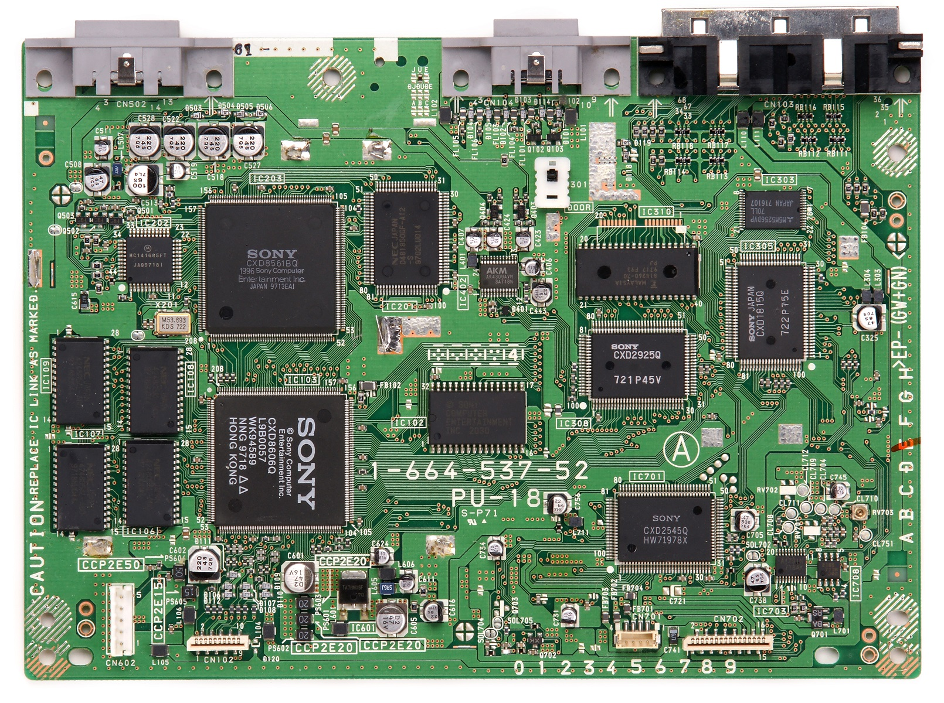

Slide 3
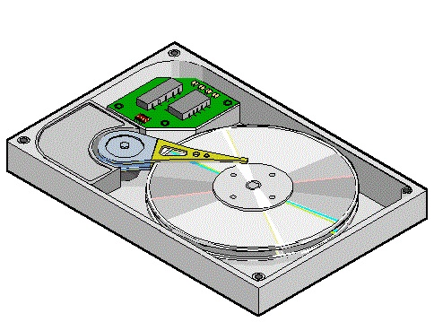
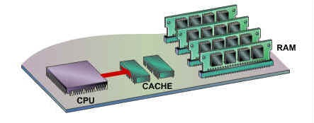
Memory Management
HARD DISK
(SECONDARY
MEMORY)
CACHE 1
(MAIN
MEMORY)
2

Slide 4
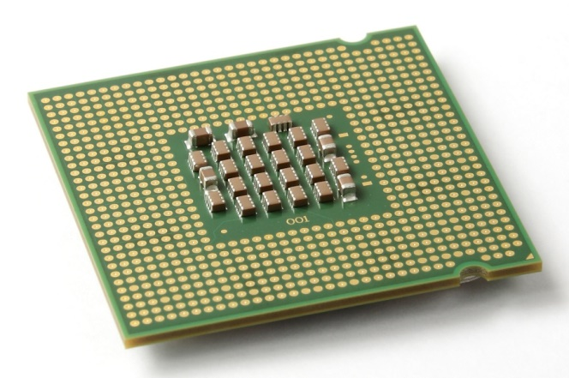
CPU

Slide 5
CPU
CACHE 1

Slide 6
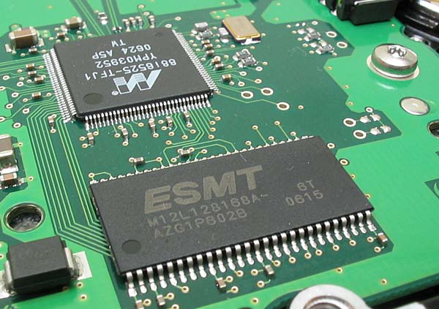
Cache

Slide 7
Cache
CPU

Slide 8
Cache
CPU
CACHE 2

Slide 9
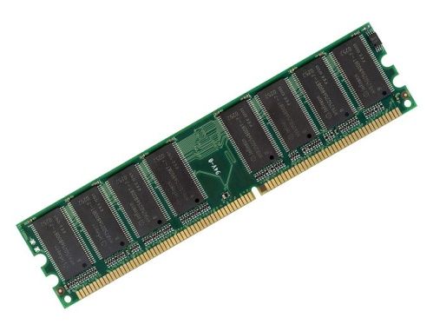
Main Memory (RAM)

Slide 10
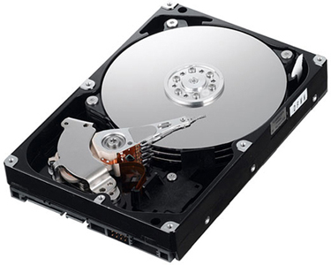
Secondary Memory (Hard Disk)

Slide 11
Memory Management
HARD DISK
(SECONDARY
MEMORY)
CACHE 1
(MAIN
MEMORY)
2

Slide 12
Memory Management
Approximate number of clock cycles to access the various elements of the memory hierarchy.
HARD DISK
(SECONDARY
MEMORY)
CACHE 1
(MAIN
MEMORY)
2
10¹

Slide 13
Memory Management
Approximate number of clock cycles to access the various elements of the memory hierarchy.
HARD DISK
(SECONDARY
MEMORY)
CACHE 1
(MAIN
MEMORY)
2
10¹
10³

Slide 14
Memory Management
Approximate number of clock cycles to access the various elements of the memory hierarchy.
HARD DISK
(SECONDARY
MEMORY)
CACHE 1
(MAIN
MEMORY)
2
10¹
10³
10⁷

Slide 15
Memory Management
Let’s consider an operating system model with a single user, and how they use memory.

Slide 16
Single-User System
MAIN
MEMORY

Slide 17
Single-User System
MAIN
MEMORY
200K
available

Slide 18
Single-User System
MAIN
MEMORY
If I create a program:
200K
available

Slide 19
Single-User System
MAIN
MEMORY
If I create a program:
PROGRAM 1
200K
available

Slide 20
Single-User System
MAIN
MEMORY
If I create a program:
to be processed, it has
to be written entirely into
Main Memory, in
contiguous space
PROGRAM 1
200K
available

Slide 21
Single-User System
PROGRAM 1
MAIN
MEMORY
200K
available

Slide 22
Single-User System
MAIN
MEMORY
PROGRAM 1
If the program is bigger and doesn’t fit in the memory, it can’t be processed.
200K
available

Slide 23
Memory Management
This is the limitation of all computers, if a program is too big, we must do one of two things:
Get more memory
Make the program smaller

Slide 24
Memory Management
To allow more than one program to run at the same time, the memory is subdivided into FIXED PARTITIONS.

Slide 25
Fixed Partitions
MAIN
MEMORY
250K

Slide 26
Fixed Partitions
PARTITION 1
100K
PARTITION 2
25K
250K
PARTITION 3
25K
PARTITION 4
50K
PARTITION 5
50K

Slide 27
Fixed Partitions
This leaves us with less memory, but at least more than one user (and their user process) can be logged into the system at the same time.
If we want to adjust the size of the partitions we need to shut down the system, go into the boot login, and then restart.

Slide 28
Fixed Partitions
To make this work, the memory manager needs to keep a Partition Table to remember the status of all the partitions.

Slide 29
Fixed Partitions
To make this work, the memory manager needs to keep a Partition Table to remember the status of all the partitions.
Partition Number | Partition Size | Memory Address | Access | Partition Status
1 | 100K | 200K | Program1 | BUSY
2 | 25K | 300K | Program4 | BUSY
3 | 25K | 325K |  | FREE
4 | 50K | 350K | Program2 | BUSY
5 | 50K | 400K |  | FREE

Slide 30
Fixed Partitions
PARTITION 1
Which looks like this in memory:
100K
PARTITION 2
25K
250K
PARTITION 3
25K
PARTITION 4
50K
PARTITION 5
50K

Slide 31
Fixed Partitions
Let’s add some programs in:
PARTITION 1
100K
PARTITION 2
25K
250K
PARTITION 3
25K
PARTITION 4
50K
PARTITION 5
50K

Slide 32
Fixed Partitions
PARTITION 1
Let’s add some programs in:
PROGRAM 1
100K
PARTITION 2
25K
250K
PARTITION 3
25K
PARTITION 4
50K
PARTITION 5
50K

Slide 33
Fixed Partitions
PARTITION 1
Let’s add some programs in:
PROGRAM 1
100K
PROGRAM 2
PARTITION 2
25K
250K
PARTITION 3
25K
PARTITION 4
50K
PARTITION 5
50K

Slide 34
Fixed Partitions
PARTITION 1
Let’s add some programs in:
PROGRAM 1
100K
PROGRAM 2
PARTITION 2
25K
250K
PARTITION 3
25K
PROGRAM 3
PARTITION 4
50K
PARTITION 5
50K

Slide 35
Fixed Partitions
PARTITION 1
Let’s add some programs in:
PROGRAM 1
100K
INTERNAL FRAGMENTATION
PROGRAM 2
PARTITION 2
25K
250K
PARTITION 3
25K
PROGRAM 3
PARTITION 4
50K
PARTITION 5
50K

Slide 36
Fixed Partitions
PARTITION 1
Let’s add some programs in:
PROGRAM 1
100K
INTERNAL FRAGMENTATION
PROGRAM 2
PARTITION 2
25K
250K
PARTITION 3
25K
PROGRAM 3
PARTITION 4
50K
INTERNAL FRAGMENTATION
PARTITION 5
50K

Slide 37
Fixed Partitions
PARTITION 1
Let’s add some programs in:
PROGRAM 1
100K
INTERNAL FRAGMENTATION
PROGRAM 2
PARTITION 2
25K
250K
EMPTY PARTITION
PARTITION 3
25K
PROGRAM 3
PARTITION 4
50K
INTERNAL FRAGMENTATION
PARTITION 5
50K

Slide 38
Fixed Partitions
PARTITION 1
Let’s add some programs in:
PROGRAM 1
100K
INTERNAL FRAGMENTATION
PROGRAM 2
PARTITION 2
25K
250K
EMPTY PARTITION
PARTITION 3
25K
PROGRAM 3
PARTITION 4
50K
INTERNAL FRAGMENTATION
PARTITION 5
EMPTY PARTITION
50K

Slide 39
Fixed Partitions
Selecting the correct set of partition sizes is a tricky business, too small and larger programs will be waiting forever to run, too big and there is a lot of wasted space.

Slide 40
Dynamic Partitions
An alternative is DYNAMIC PARTITIONS, where a program is given the space it requests, if there is space available for it.
This takes care of lots of problems.

Slide 41
Dynamic Partitions
Let’s add some programs in:
MAIN
MEMORY
250K

Slide 42
Dynamic Partitions
Let’s add some programs in:
MAIN
MEMORY
PROGRAM 1
250K

Slide 43
Dynamic Partitions
MAIN
MEMORY
Let’s add some programs in:
PROGRAM 1
250K

Slide 44
Dynamic Partitions
MAIN
MEMORY
Let’s add some programs in:
PROGRAM 1
PROGRAM 2
250K

Slide 45
Dynamic Partitions
MAIN
MEMORY
Let’s add some programs in:
PROGRAM 1
PROGRAM 2
250K

Slide 46
Dynamic Partitions
MAIN
MEMORY
Let’s add some programs in:
PROGRAM 1
PROGRAM 3
PROGRAM 2
250K

Slide 47
Dynamic Partitions
MAIN
MEMORY
Let’s add some programs in:
PROGRAM 1
PROGRAM 2
PROGRAM 3
250K

Slide 48
Dynamic Partitions
MAIN
MEMORY
Let’s add some programs in:
PROGRAM 1
PROGRAM 2
PROGRAM 4
PROGRAM 3
250K

Slide 49
Dynamic Partitions
MAIN
MEMORY
Let’s add some programs in:
PROGRAM 1
PROGRAM 2
PROGRAM 3
250K
PROGRAM 4

Slide 50
Dynamic Partitions
MAIN
MEMORY
Let’s add some programs in:
PROGRAM 1
PROGRAM 2
PROGRAM 5
PROGRAM 3
250K
PROGRAM 4

Slide 51
Dynamic Partitions
MAIN
MEMORY
Let’s add some programs in:
PROGRAM 1
PROGRAM 2
PROGRAM 5
PROGRAM 3
250K
WAIT
PROGRAM 4

Slide 52
Dynamic Partitions
It isn’t perfect, because the next program will go into the slot that is freed up by a completed program.

Slide 53
Dynamic Partitions
MAIN
MEMORY
Let’s add some programs in:
PROGRAM 1
PROGRAM 2
PROGRAM 5
PROGRAM 3
250K
WAIT
PROGRAM 4

Slide 54
Dynamic Partitions
MAIN
MEMORY
Let’s add some programs in:
PROGRAM 1
PROGRAM 2
PROGRAM 5
PROGRAM 3
250K
WAIT
PROGRAM 4

Slide 55
Dynamic Partitions
Let’s add some programs in:
PROGRAM 1
PROGRAM 2
PROGRAM 5
250K
WAIT
PROGRAM 4

Slide 56
Dynamic Partitions
Let’s add some programs in:
PROGRAM 1
PROGRAM 2
PROGRAM 5
250K
PROGRAM 4

Slide 57
Dynamic Partitions
Let’s add some programs in:
PROGRAM 1
PROGRAM 2
PROGRAM 5
250K
EXTERNAL FRAGMENTATION
PROGRAM 4
So, however we partition, we end up with fragmentation, one way or the other.

Slide 58
Partitions
PROGRAM 1
PROGRAM 2
PROGRAM 3
250K
PROGRAM 4
PROGRAM 5

Slide 59
Partitions
PROGRAM 1
So how do we decide where to slot in a new program?
PROGRAM 2
PROGRAM 3
250K
PROGRAM 4
PROGRAM 5

Slide 60
Partitions
PROGRAM 1
So how do we decide where to slot in a new program?
PROGRAM 2
PROGRAM 3
PROGRAM 6
250K
PROGRAM 4
PROGRAM 5

Slide 61
Partitions
PROGRAM 1
Here is the first slot free
PROGRAM 2
PROGRAM 3
PROGRAM 6
250K
PROGRAM 4
PROGRAM 5

Slide 62
Partitions
PROGRAM 1
Here is the first slot free
PROGRAM 2
PROGRAM 6
PROGRAM 3
250K
PROGRAM 4
PROGRAM 5

Slide 63
Partitions
PROGRAM 1
But here’s a better fit
PROGRAM 2
PROGRAM 6
PROGRAM 3
250K
PROGRAM 4
PROGRAM 5

Slide 64
Partitions
PROGRAM 1
But here’s a better fit
PROGRAM 2
PROGRAM 3
250K
PROGRAM 6
PROGRAM 4
PROGRAM 5

Slide 65
Partitions
So, we can either add the new block to the first available slot (FIRST-FIT ALGORITHM) or we can add the new block to the most suitable available slot (BEST-FIT ALGORITHM).

Slide 66
Partitions
If the Memory Manager wants a FIRST-FIT ALGORITHM then it stores a table in order of memory locations.
If the Memory Manager wants a BEST-FIT ALGORITHM then it stores a table in order of size of memory locations.
Starts | Size | Status
315 | 40 | FREE
250 | 50 | FREE
Starts | Size | Status
200 | 50 | BUSY
250 | 50 | FREE
300 | 15 | BUSY
315 | 40 | FREE
355 | 25 | BUSY
Starts | Size | Status
300 | 15 | BUSY
355 | 25 | BUSY
315 | 40 | BUSY

Slide 67
Deallocating space
After a program is completed, there are three cases for deallocating space in memory:

Slide 68
Deallocating space
1. There are programs either side of the freed space:
PROGRAM 5
PROGRAM 5
PROGRAM 3
PROGRAM 3
PROGRAM 6
PROGRAM 4
PROGRAM 4
PROGRAM 8
PROGRAM 8

Slide 69
Deallocating space
2. There is a program on one side, and it’s free on the other side of the freed space:
PROGRAM 5
PROGRAM 5
PROGRAM 3
PROGRAM 3
PROGRAM 6
PROGRAM 8
PROGRAM 8

Slide 70
Deallocating space
3. There are no programs on either side of the freed space:
PROGRAM 5
PROGRAM 5
PROGRAM 6
PROGRAM 8
PROGRAM 8

Slide 71
Deallocating space
Let’s look at the implications of each of these cases in terms of what the Memory Manager must do to remember the FREE and BUSY memory spaces.

Slide 72
Deallocating space
1. There are programs either side of the freed space:
PROGRAM 5
PROGRAM 5
PROGRAM 3
PROGRAM 3
PROGRAM 6
PROGRAM 4
PROGRAM 4
PROGRAM 8
PROGRAM 8

Slide 73
Deallocating space
1. There are programs either side of the freed space:
200-250
PROGRAM 5
PROGRAM 5
200-250
250-300
PROGRAM 3
PROGRAM 3
250-300
300-315
PROGRAM 6
300-315
315-340
PROGRAM 4
PROGRAM 4
315-340
340-355
340-355
355-380
PROGRAM 8
PROGRAM 8
355-380

Slide 74
Deallocating space
1. There are programs either side of the freed space:
200-250
Starts | Size | Status
200 | 50 | BUSY
250 | 50 | BUSY
300 | 15 | BUSY
315 | 25 | BUSY
340 | 15 | FREE
355 | 25 | BUSY
Starts | Size | Status
200 | 50 | BUSY
250 | 50 | BUSY
300 | 15 | FREE
315 | 25 | BUSY
340 | 15 | FREE
355 | 25 | BUSY
200-250
250-300
250-300
300-315
300-315
315-340
315-340
340-355
340-355
355-380
355-380

Slide 75
Deallocating space
2. There are is a program on one side, and it’s free on the other side of the freed space:
PROGRAM 5
PROGRAM 5
PROGRAM 3
PROGRAM 3
PROGRAM 6
PROGRAM 8
PROGRAM 8

Slide 76
Deallocating space
2. There is a program on one side, and it’s free on the other side of the freed space:
200-250
PROGRAM 5
PROGRAM 5
200-250
250-300
PROGRAM 3
PROGRAM 3
250-300
300-315
PROGRAM 6
300-355
315-355
355-380
PROGRAM 8
PROGRAM 8
355-380

Slide 77
Deallocating space
2. There are is a program on one side, and it’s free on the other side of the freed space:
200-250
Starts | Size | Status
200 | 50 | BUSY
250 | 50 | BUSY
300 | 15 | BUSY
315 | 40 | FREE
355 | 25 | BUSY
Starts | Size | Status
200 | 50 | BUSY
250 | 50 | BUSY
300 | 15 | FREE
315 | 40 | FREE
355 | 25 | BUSY
200-250
250-300
250-300
300-315
300-355
315-355
355-380
355-380

Slide 78
Deallocating space
2. There are is a program on one side, and it’s free on the other side of the freed space:
Starts | Size | Status
200 | 50 | BUSY
250 | 50 | BUSY
300 | 15 | BUSY
315 | 40 | FREE
355 | 25 | BUSY
Starts | Size | Status
200 | 50 | BUSY
250 | 50 | BUSY
300 | 15 | FREE
315 | 40 | FREE
355 | 25 | BUSY

Slide 79
Deallocating space
2. There are is a program on one side, and it’s free on the other side of the freed space:
Starts | Size | Status
200 | 50 | BUSY
250 | 50 | BUSY
300 | 15 | BUSY
315 | 40 | FREE
355 | 25 | BUSY
Starts | Size | Status
200 | 50 | BUSY
250 | 50 | BUSY
300 | 15 | FREE
315 | 40 | FREE
355 | 25 | BUSY
Starts | Size | Status
200 | 50 | BUSY
250 | 50 | BUSY
300 | 55 | FREE
355 | 25 | BUSY

Slide 80
Deallocating space
3. There are no programs on either side of the freed space:
PROGRAM 5
PROGRAM 5
PROGRAM 6
PROGRAM 8
PROGRAM 8

Slide 81
Deallocating space
3. There are no programs on either side of the freed space:
200-250
PROGRAM 5
PROGRAM 5
200-250
250-300
250-355
300-315
PROGRAM 6
315-355
355-380
PROGRAM 8
PROGRAM 8
355-380

Slide 82
Deallocating space
3. There are no programs on either side of the freed space:
200-250
Starts | Size | Status
200 | 50 | BUSY
250 | 50 | FREE
300 | 15 | BUSY
315 | 40 | FREE
355 | 25 | BUSY
Starts | Size | Status
200 | 50 | BUSY
250 | 50 | FREE
300 | 15 | FREE
315 | 40 | FREE
355 | 25 | BUSY
200-250
250-300
250-355
300-315
315-355
355-380
355-380

Slide 83
Deallocating space
3. There are no programs on either side of the freed space:
Starts | Size | Status
200 | 50 | BUSY
250 | 50 | FREE
300 | 15 | BUSY
315 | 40 | FREE
355 | 25 | BUSY
Starts | Size | Status
200 | 50 | BUSY
250 | 50 | FREE
300 | 15 | FREE
315 | 40 | FREE
355 | 25 | BUSY

Slide 84
Deallocating space
3. There are no programs on either side of the freed space:
Starts | Size | Status
200 | 50 | BUSY
250 | 50 | FREE
300 | 15 | BUSY
315 | 40 | FREE
355 | 25 | BUSY
Starts | Size | Status
200 | 50 | BUSY
250 | 50 | FREE
300 | 15 | FREE
315 | 40 | FREE
355 | 25 | BUSY
Starts | Size | Status
200 | 50 | BUSY
250 | 105 | FREE
355 | 25 | BUSY

